Slide 1
WELCOME to
SUNDAY SCHOOL Zoom
GRII Singapore
03-10-2021

Slide 2
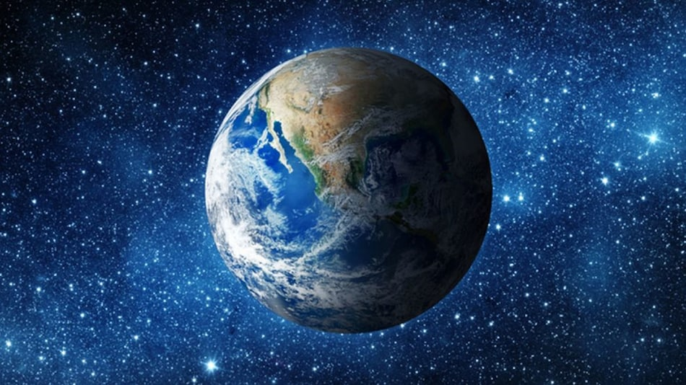

Slide 3


Slide 4


Slide 5
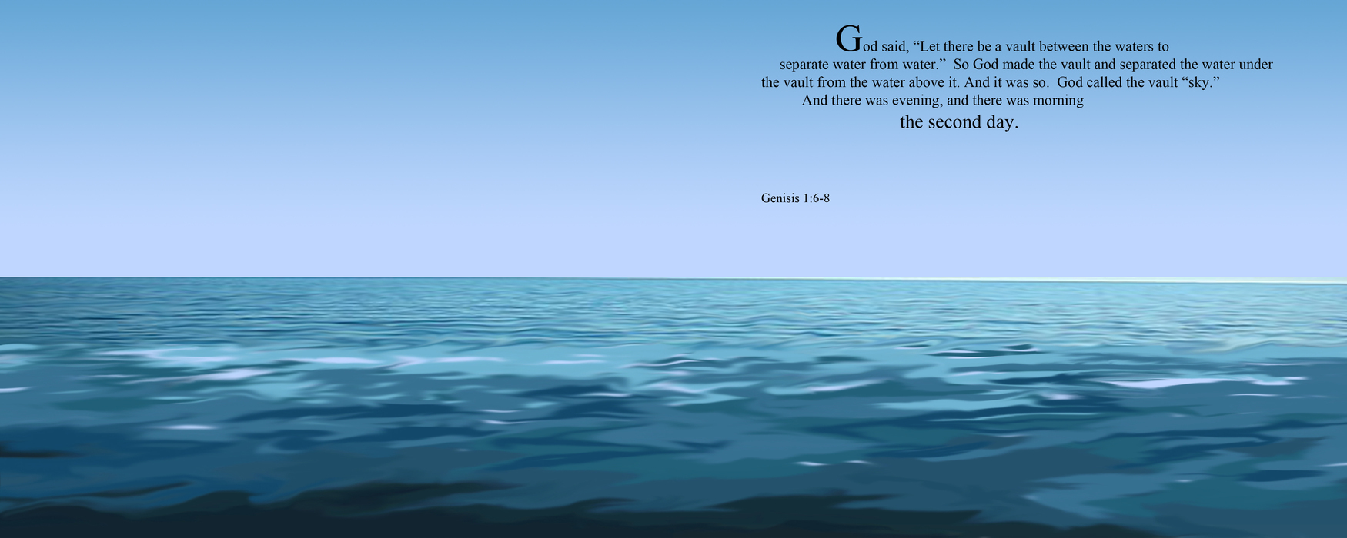

Slide 6


Slide 7
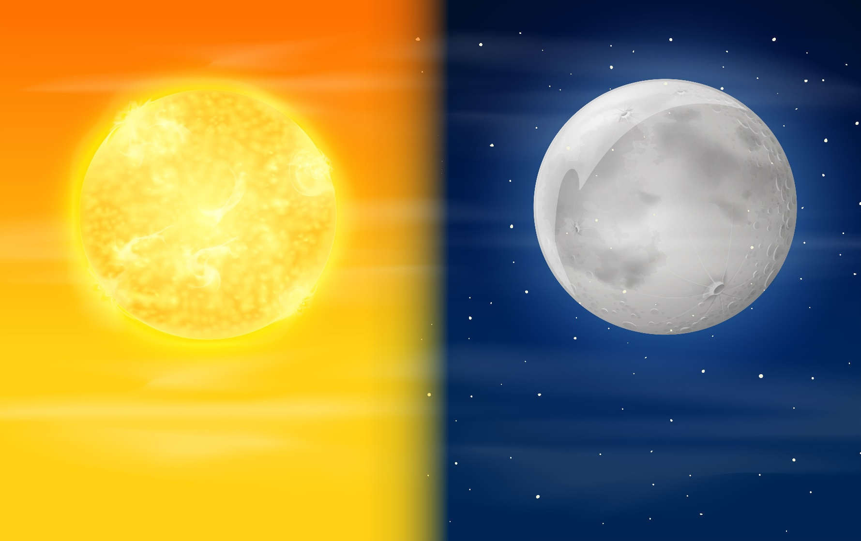

Slide 8


Slide 9


Slide 10
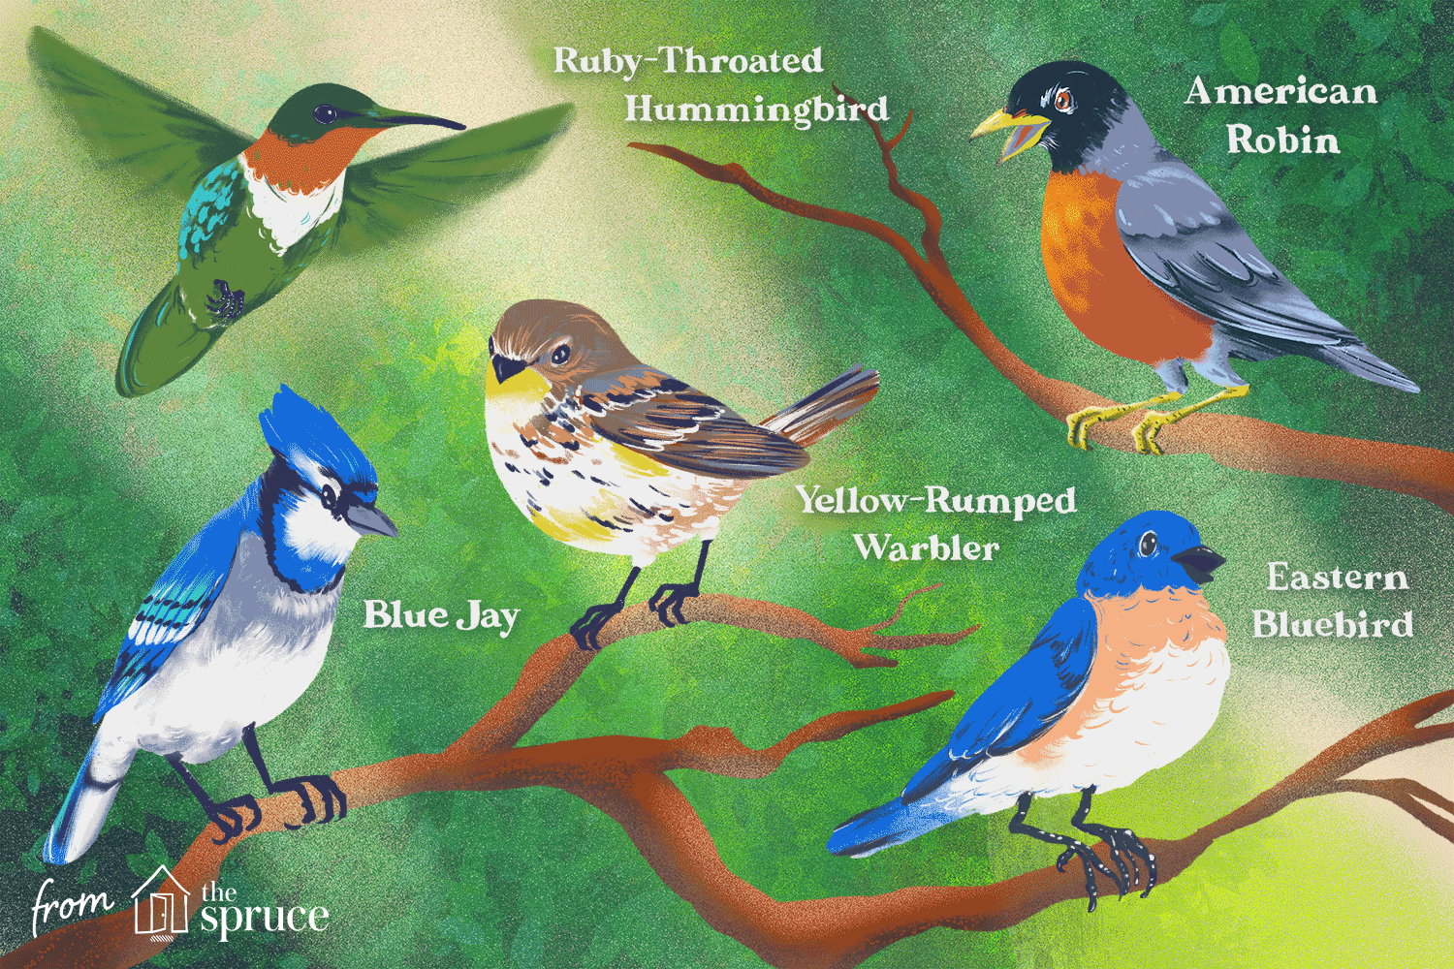

Slide 11
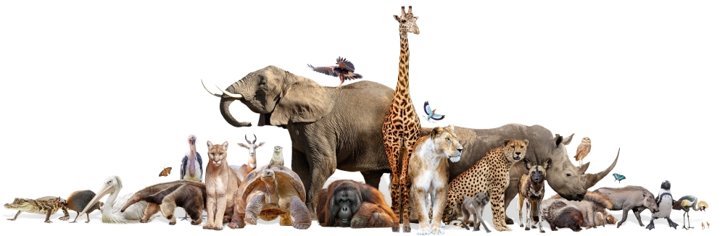

Slide 12


Slide 13
TRINITY
GOD the Father
GOD the Son
God the Holy Spirit

Slide 14
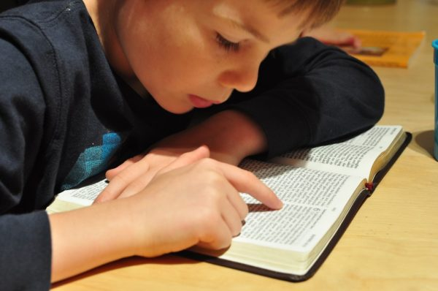

Slide 15
Genesis 1: 26
Then GOD said “Let US make MAN
IN OUR IMAGE, after OUR likeness..”
Genesis 1: 27
So GOD created man in
HIS OWN IMAGE.
IN THE IMAGE OF GOD
HE created him, male and female
HE created them.

Slide 16


Slide 17
IMAGE OF GOD
It is not physical meaning
God is Spirit
IMAGE OF GOD
IS REFERRING TO
GOD’S CHARACTER

Slide 18
IMAGE OF GOD
HOLY
JUST
LOVING
COMPASSIONATE
KIND
ETERNAL

Slide 19
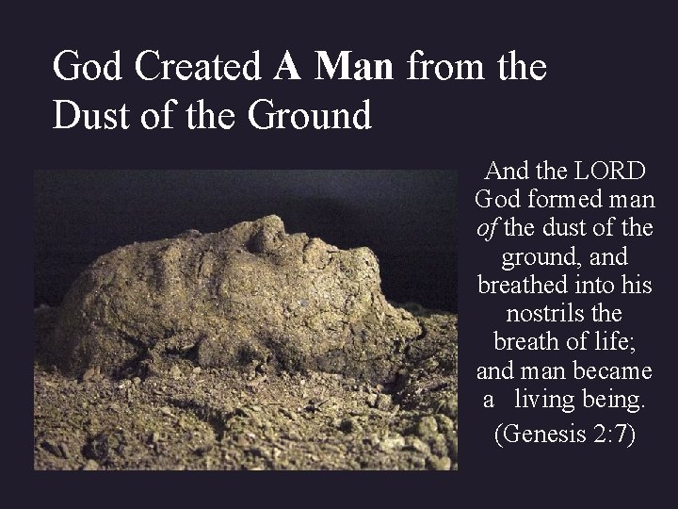

Slide 20
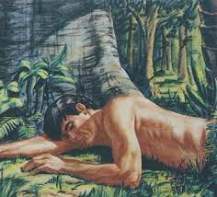


Slide 21


Slide 22
MAN IS MAN
WOMAN IS WOMAN

Slide 23
FAMILY START
WITH
MAN AND WOMAN
ALL ARE DESIGNED BY
GOD
OUR CREATOR

Slide 24

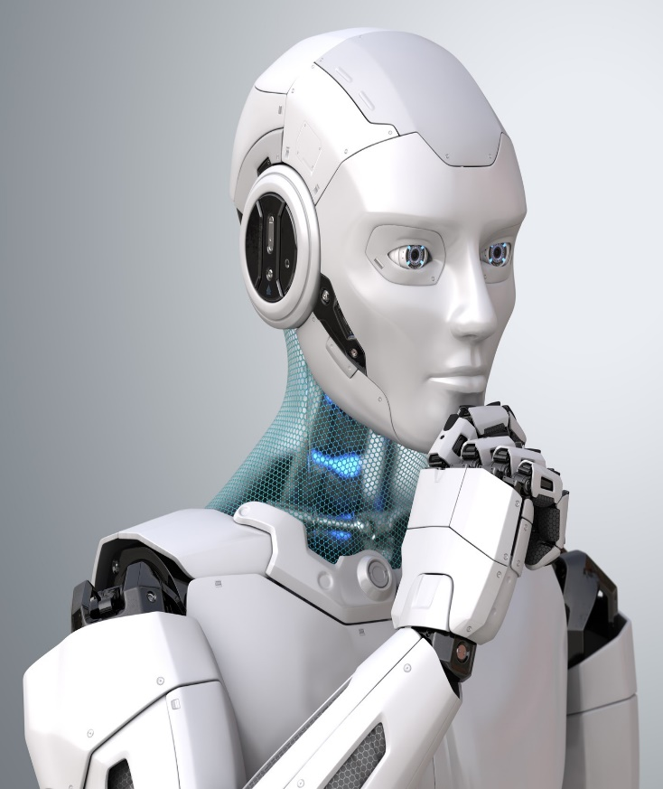

Slide 25
MAN HIGHER THAN ROBOT or ANIMAL
FREEDOM X LIMITED
ETERNAL SOUL X TEMPORAL
RELATIONSHIP WITH GOD
X NO RELATIONSHIP WITH GOD

Slide 26
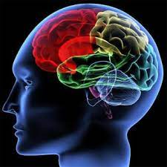
MIND TO THINK
ABOUT GOD

Slide 27

HEART TO LOVE GOD

Slide 28

CHOOSE TO
SERVE GOD, TO OBEY GOD

Slide 29
GOD

Slide 30

GOD

Slide 31
Who is our example of life ?

Slide 32
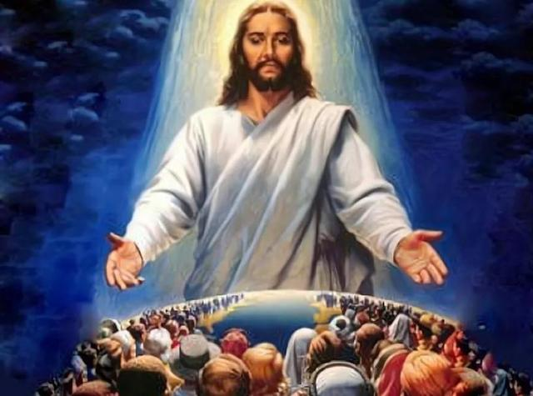
Jesus Christ

Slide 33
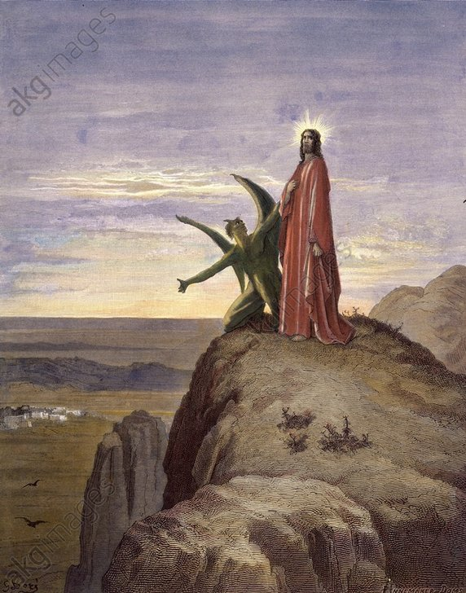
HOLY

Slide 34
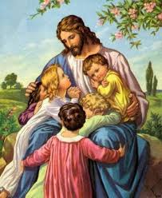
LOVING

Slide 35
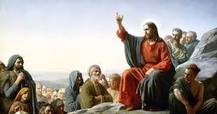
COMPASSION

Slide 36
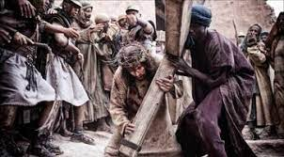
KIND

Slide 37
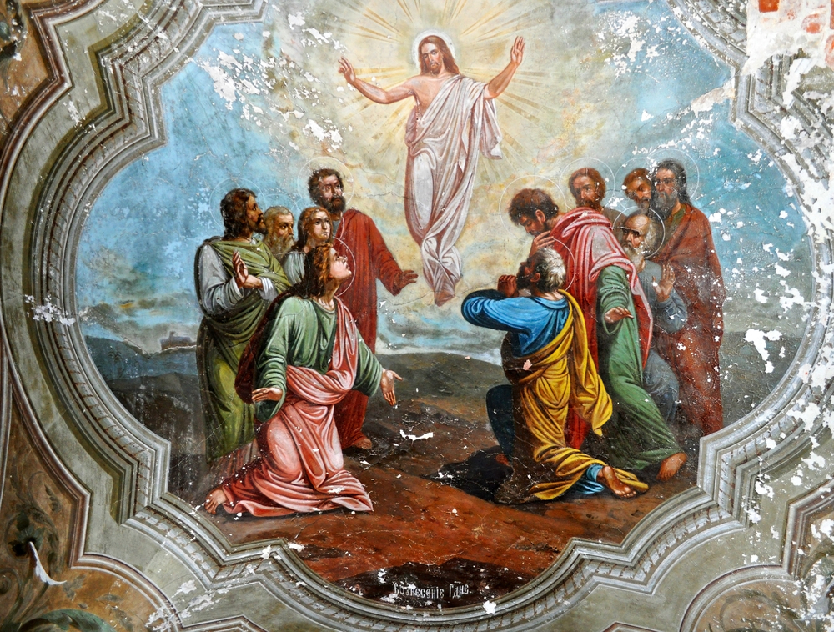
ETERNAL

Slide 38

GLORIFY THE LORD
PEACEFUL & JOYFUL

Slide 39

MESSY LIFE

Slide 41
Know that the LORD is GOD.
It is HE who made us and we are HIS
PSALM 100 :3A

